Slide 1

Introduction to NodeJS
Day 1 (2 hours)

Slide 2
What is NodeJS?
Open source server environment
Free
Runs on various platforms (Windows, Linux, Unix, Mac OS X, etc.)
Uses JavaScript on the server

Slide 3
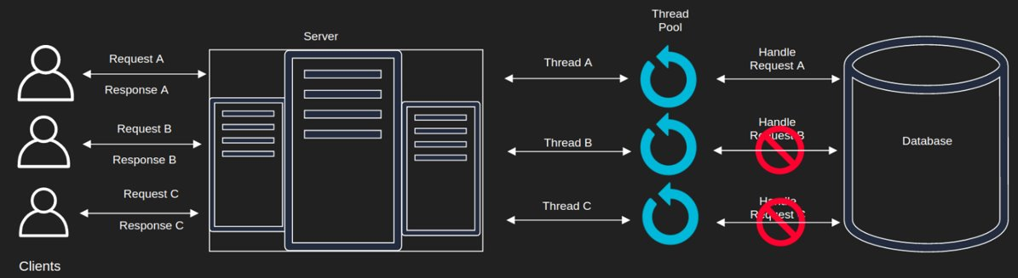
Multithreaded Environment

Slide 4
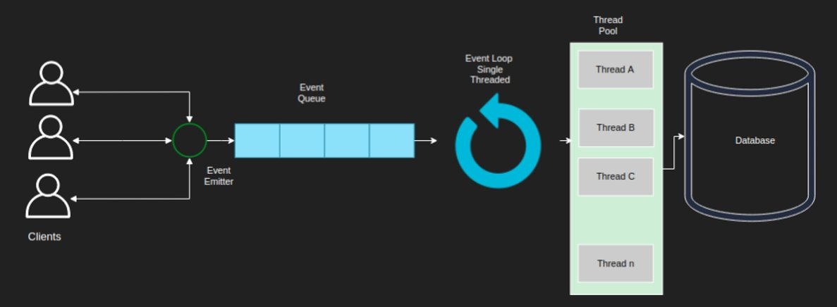
Single Threaded Environment

Slide 5
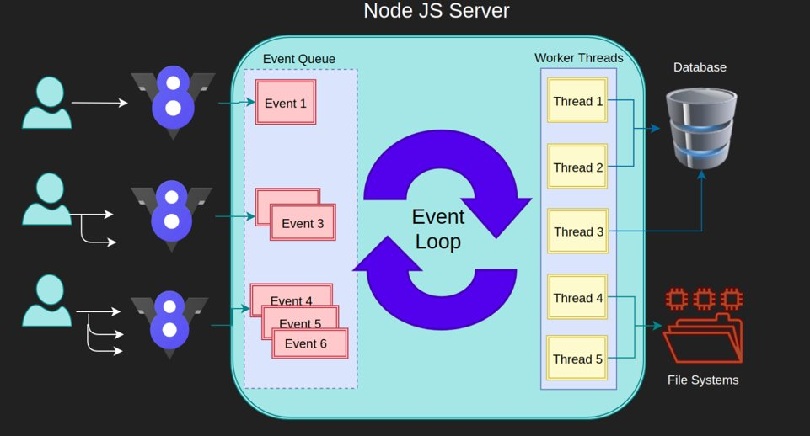
Node Architecture

Slide 6

Install NodeJS on linux box
“sudo apt install nodejs” should do the magic
Use the following commands to update and upgrade the package manager:
sudo apt-get update
sudo apt-get upgrade
Install Python software libraries using the following command:
sudo apt-get install python-software-properties
Add Node.js PPA to the system.
curl -sL https://deb.nodesource.com/setup_10.x | sudo -E bash –
Note: Here, we are installing node.js version 10, if you want to install version 14, you can replace setup_10.x with setup_14.x.
To Install Node.js and NPM to your Ubuntu machine, use the command given below:
sudo apt-get install nodejs

Slide 7

Install NodeJS on Windows box
Download Node.js Installer
In a web browser, navigate to https://nodejs.org/en/download/. Click the Windows Installer button to download the latest default version.
You can also use the top link to switch from the stable LTS version to the current version. If you are new to Node.js or don’t need a specific version, choose LTS.
Install Node.js and NPM from Browser
Once the installer finishes downloading, launch it. Open the downloads link in your browser and click the file. Or, browse to the location where you have saved the file and double-click it to launch.
The system will ask if you want to run the software – click Run.
You will be welcomed to the Node.js Setup Wizard – click Next.
On the next screen, review the license agreement. Click Next if you agree to the terms and install the software.
The installer will prompt you for the installation location. Leave the default location, unless you have a specific need to install it somewhere else – then click Next.
The wizard will let you select components to include or remove from the installation. Again, unless you have a specific need, accept the defaults by clicking Next.
Finally, click the Install button to run the installer. When it finishes, click Finish.

Slide 8
Check Installation
node –v
npm -v

Slide 9
Manage Node Installations using NVM
Installation of NVM
First download the NVM installation script using cURL as follows
$ curl -o- https://raw.githubusercontent.com/creationix/nvm/v0.34.0/install.sh | bash
After downloading the script, run the script using bash as follows
$ bash install_nvm.sh
To reflect the changes for the current user session, use following command
$ source ~/.profile
Installation of NVM (windows)
https://github.com/coreybutler/nvm-windows/releases/tag/1.1.7
Download nvm-setup.zip
Extract and install the exe

Slide 10

NVM commands
Check installed NVM version as follows
nvm version
Command to list all available node.js versions
nvm ls-remote
nvm list available (for windows)
Install particular node version
nvm install 10.15 # it will install node 10.15.0
To see all installed node version
nvm list
To use particular node version use
nvm use 10.15 # it will use node 10.15.0
To check node and npm version
node -v
npm -v

Slide 11
Create your first NodeJS App
Create a Node.js file named "helloworld.js", and add the attached code
Save the file on your computer: C:\Users\Your Name\helloworld.js
The code tells the computer to write "Hello World!" if anyone (e.g. a web browser) tries to access your computer on port 8080.
var http = require('http'); http.createServer(function (req, res) { res.writeHead(200, {'Content-Type': 'text/html'}); res.end('Hello World!'); }).listen(8080);

Slide 12
Debugging in NodeJS
Built in Node Debugger
Node.js includes an out-of-process debugging utility accessible via a V8 Inspector and built-in debugging client. To use it, start Node.js with the inspect argument followed by the path to the script to debug; a prompt will be displayed indicating successful launch of the debugger:
node inspect <filename.js>
The Node.js debugger client is not a full-featured debugger, but simple step and inspection are possible.
Inserting the statement debugger; into the source code of a script will enable a breakpoint at that position in the code

Slide 13
Debugging : Chrome Developer Tools
Using Third Party Debugger
node --inspect index.js
# Break on the first statement of the script with --inspect-brk
node --inspect-brk index.js
Navigate to chrome://inspect on your chrome browser
Click the Open dedicated DevTools for Node link.
You’ll get a popup window for debugging your node session.
But better than that, when you kill and restart node, the window will automatically reconnect to it.

Slide 14
Debugging : ndb
npm install -g ndb
ndb node <path/to/file/.js>
Add a breakpoint in your code
Then open http://localhost:8081/
Now as the app should pause at the breakpoint, Enjoy! and continue debugging.
* Sometimes we may get power shell access issues in windows to run ndb
* Run the below command to give PS full access
Set-ExecutionPolicy -Scope CurrentUser -ExecutionPolicy Unrestricted

Slide 15
Debugging on VS Code

Slide 16
Assignment
1. Create your own node js server to listening on port 8000
2. If URL contains "name" attribute like "localhost:8000/name", then print your name on browser else if localhost:8000/xyz then print "I don’t know the name"

Slide 17

Q n A

